Slide 1
Unit 6
I/O management: I/O Devices - Types, Characteristics of devices, I/O Buffering. Disk Scheduling: FCFS, SSTF, SCAN, C-SCAN

Slide 2
Device Management
Device Management in Operating system manages all the hardware or virtual devices of a computer or PC.
As all the processes of a PC are controlled or handled by the operating system,
the hardware devices, and virtual devices are handled by the Device Management system of the Operating system.
The operating system and hardware or the devices of the computer are not connected directly to each other they are connected to each other through special programs known as drivers.

Slide 3
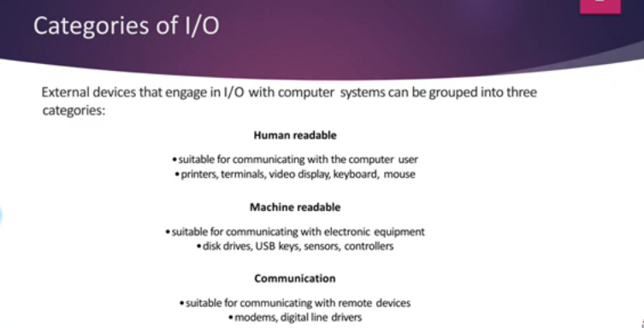
I/O Devices - Types
Input and output device management.

Slide 4
Features of Device Management in Operating System
The operating system is responsible in managing device communication through their respective drivers.
The operating system keeps track of all devices by using a program known as an input-output controller.
It decides which process to assign to CPU and for how long.
O.S. is responsible in fulfilling the request of devices to access the process.
It connects the devices to various programs in an efficient way without error.
Deallocate devices when they are not in use.

Slide 5
Characteristics of I/O Devices
Each I/O device has unique characteristics that influence its interaction with the operating system and its performance.
These characteristics include:
Data Rate:
Speed: I/O devices vary greatly in their speed of data transmission.
For example, a hard disk might transfer data at hundreds of megabytes per second, while a printer might only process a few kilobytes per second.
CPU and Memory Overhead: Devices like keyboards and mouse generate interrupts for every keypress or movement, which can introduce overhead if not managed efficiently.

Slide 6
Characteristics of I/O Devices
2. Block vs. Character Devices:
Character Devices:
These handle data as a stream of characters.
Examples include keyboards and mouse.
They provide input/output in small units (character by character).
Block Devices:
These handle data in blocks or chunks, typically used for storage devices like HDDs and SSDs.
Block devices allow random access to data, meaning you can read/write at any point in the storage medium.

Slide 7
Characteristics of I/O Devices
3. Sequential vs. Random Access:
Sequential Access:
Devices like tape drives access data in a sequence.
If you want to read data stored towards the end of the tape, you must go through all the earlier data first.
Random Access:
Devices like SSDs and HDDs allow random access, meaning data can be retrieved or written anywhere in memory without the need to process other data sequentially.

Slide 8
Characteristics of I/O Devices
4. Shared vs. Dedicated Devices:
Shared Devices:
Devices that multiple users or processes can share simultaneously.
An example is a printer in a network, which can receive print jobs from several users.
Dedicated Devices:
Devices used by one user or process at a time.
For example, a mouse or keyboard is typically a dedicated device.

Slide 9
Characteristics of I/O Devices
5. Transfer Mechanism:
Programmed I/O (PIO)/Polling:
Data is transferred under direct control of the CPU.
CPU constantly checks the I/O device to see if it is ready to send or receive data.
This can be slow and inefficient because the CPU is busy waiting for the device, even if the device is not ready yet.
Interrupt-Driven I/O:
The CPU doesn’t constantly check the I/O device.
Instead, the device sends an interrupt (a signal) to the CPU when it’s ready to transfer data.
This reduces CPU overhead because the CPU can do other tasks until the device is ready.

Slide 10
Characteristics of I/O Devices
5. Transfer Mechanism:
Direct Memory Access (DMA):
in this method, a special piece of hardware called the DMA controller handles the data transfer.
The CPU tells the DMA controller what to do and then goes on with its work.
The DMA controller transfers data directly between the I/O device and the memory without involving the CPU.
Once the transfer is complete, the DMA controller tells the CPU that the task is done.
Most efficient because the CPU is free to work on other tasks because the DMA controller manages the transfer.

Slide 11
Characteristics of I/O Devices
6. Error Handling:
Different devices have varying capacities for handling errors.
Some devices can detect and correct errors on their own (like modern storage devices with error-correcting codes),
while others may rely on the CPU to manage and recover from errors.

Slide 12
IO Buffering:
A buffer is a memory area that stores data temporarily ,that is being transferred between two devices or between a device and an application.
I/O buffering is a technique used in computer systems to improve the efficiency of input and output (I/O) operations.
It involves the temporary storage of data in a buffer, to reduce the number of I/O operations and manage the flow of data between fast and slow devices or processes

Slide 13
Why Buffering is Needed
Speed Mismatch:
I/O devices (e.g., hard drives, printers) often work much slower than the CPU and main memory.
Without a buffer, the CPU might have to wait for the slow device to finish transferring data, reducing system efficiency.
Data Consistency:
Sometimes, data is not available all at once (for example, when reading from a slow device). A buffer can hold partial data until the full data is ready for processing.

Slide 14
Why Buffering is Needed
Managing Bursts of Data:
Some devices send data in bursts (like network cards),
and if the system isn’t ready to handle it immediately, buffering ensures the data isn’t lost.

Slide 15
Types of Buffering
There are three main types of buffering in the operating system, such as:
Single Buffer
Double Buffer
Circular Buffer

Slide 16
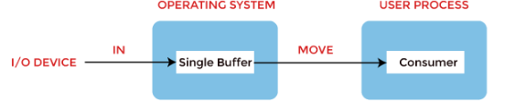
Types of Buffering
Single Buffer:
A single buffer is allocated in memory, and the system uses it to store data from the I/O device.
How it works:
While one part of the system (e.g., the CPU) processes the data in the buffer, the I/O device stores more data into the same buffer.
Once the CPU finishes processing, it can use the new data from the same buffer.
Limitation:
The CPU may still need to wait if the buffer is full or if the I/O device hasn’t yet filled the buffer with new data.

Slide 17
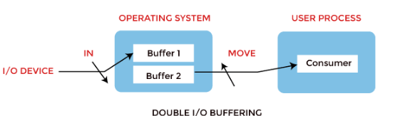
Types of Buffering
2. Double Buffering:
In double buffering, two buffers are used.
While one buffer is being filled by the I/O device, the other buffer is processed by the system (e.g., CPU).
How it works:
The I/O device writes data to the first buffer
while the CPU reads data from the second buffer.
Once the CPU is done processing one buffer, it switches to the other, allowing both data transfer and processing to happen in parallel.

Slide 18
Types of Buffering
2. Double Buffering:
Example:
Imagine you have two bottles. While you’re filling one bottle with water, the other is being emptied. This way, there’s always some water being processed, and there’s no need to wait for one bottle to be filled or emptied.
Benefit:
It minimizes waiting time and improves overall system efficiency since the CPU and I/O device can work simultaneously.

Slide 19
Types of Buffering
3. Circular Buffer (Ring Buffer):
When more than two buffers are used, the buffers' collection is called a circular buffer.
A circular buffer is a buffer that works like a loop.
When the end of the buffer is reached, it wraps around to the beginning.
It’s useful when dealing with continuous streams of data, like in audio or video processing.
How it works:
Data is written into the buffer in a circular fashion.
When the end of the buffer is reached, the new data is written starting from the beginning (if there’s space),
and the reading process follows the same circular pattern.

Slide 20
Types of Buffering
3. Circular Buffer (Ring Buffer):
When more than two buffers are used, the buffers' collection is called a circular buffer.
A circular buffer is a buffer that works like a loop.
When the end of the buffer is reached, it wraps around to the beginning.
It’s useful when dealing with continuous streams of data, like in audio or video processing.
How it works:
Data is written into the buffer in a circular fashion.
When the end of the buffer is reached, the new data is written starting from the beginning (if there’s space),
and the reading process follows the same circular pattern.
When the end of the buffer is reached, the writing starts again from the beginning, overwriting the oldest data if it hasn’t been read or processed yet.

Slide 21
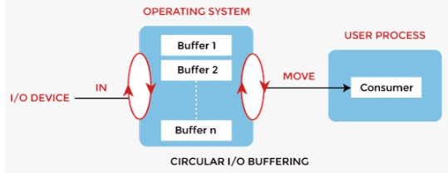
Types of Buffering
3. Circular Buffer (Ring Buffer):
Real-World Example:
Music Streaming: When you're streaming music, the app doesn't download the whole song at once.
Instead, it uses a circular buffer to store parts of the song (small chunks of audio data) as they arrive.
The buffer continuously refills as you listen, with new audio data replacing the old as it’s played, ensuring smooth playback without interruptions.

Slide 22
Disk scheduling Algorithm

Slide 23
Disk scheduling
Disk scheduling is a technique operating systems use to manage the order in which disk I/O (input/output) requests are processed.
Disk scheduling algorithms are managing how data is read from and written to a computer’s hard disk
Disk scheduling is also known as I/O Scheduling.
The main goals of disk scheduling are to optimize the performance of disk operations,
reduce the time it takes to access data and improve overall system efficiency.

Slide 24
Importance of Disk scheduling algo
Multiple I/O requests may arrive by different processes and only one I/O request can be served at a time by the disk controller.
Thus other I/O requests need to wait in the waiting queue and need to be scheduled.
Two or more requests may be far from each other so this can result in greater disk arm movement.
Hard drives are one of the slowest parts of the computer system & need to be accessed in an efficient manner.

Slide 25
Key Terms Associated with Disk Scheduling
Seek Time: Seek time is the time taken to locate the disk arm to a specified track where the data is to be read or written.
Transfer Time: Transfer time is the time to transfer the data. It depends on the rotating speed of the disk and the number of bytes to be transferred.
Rotational Latency is the time it takes for the disk to spin so that the desired part (sector) of the disk aligns with the read/write head.
Disk Access Time:
Disk Access Time = Seek Time + Rotational Latency + Transfer Time
Total Seek Time = Total head Movement * Seek Time

Slide 26
Disk scheduling
Common disk scheduling methods include :
First-Come First-Served (FCFS),
Shortest Seek Time First (SSTF),
SCAN,
C-SCAN,
LOOK, and
C-LOOK.

Slide 27
Disk Scheduling: FCFS
It services the IO requests in the order in which they arrive.
There is no starvation in this algorithm, every request is serviced.
Disadvantages
The scheme does not optimize the seek time.
The request may come from different processes therefore there is the possibility of inappropriate movement of the head.

Slide 28
Disk Scheduling: FCFS
Consider the following disk request sequence for a disk with 100 tracks 45, 21, 67, 90, 4, 50, 89, 52, 61, 87, 25
Head pointer starting at 50 and moving in left direction. Find the number of head movements in cylinders using FCFS scheduling.

Slide 29
disk with 100 tracks 45, 21, 67, 90, 4, 50, 89, 52, 61, 87, 25 & Head pointer starting at 50
25
87
61
52
89
50
4
90
67
21
45
0
10
20
30
40
50
60
70
80
90
100

Slide 30
Answer:
disk with 100 tracks 45, 21, 67, 90, 4, 50, 89, 52, 61, 87, 25 & Head pointer starting at 50
Number of cylinders moved by the head:
(50-45)+(45-21)+(67-21)+(90-67)+(90-4)+(50-4)+(89-50)+(61-52)+(87-61)+(87-25)
= 5 + 24 + 46 + 23 + 86 + 46 + 49 + 9 + 26 + 62
= 376

Slide 31
SSTF Scheduling Algorithm
SSTF (Shortest Seek Time First) is a disk scheduling algorithm that selects the disk request that is closest to the current position of the disk head.
It reduces the total seek time by always serving the request that requires the least movement of the read/write head
How SSTF Works:
The disk head starts at a specific track.
From the queue of pending requests, SSTF selects the one that is nearest to the current head position.
After servicing that request, it repeats the process, always selecting the next closest request.
.

Slide 32
SSTF Scheduling Algorithm
Advantages:
Reduced Seek Time: SSTF minimizes the overall seek time compared to FCFS by servicing the closest requests first.
Better Performance: It is more efficient than FCFS in reducing disk head movement.
Disadvantages:
Starvation: Some requests may get delayed for a long time, especially if new, closer requests keep arriving.
Not Optimal: no. of overheads are more because at every stage we have to find nearest track.

Slide 33
SSTF Scheduling Algorithm Example
Consider the following disk request sequence for a disk with 100 tracks
45, 21, 67, 90, 4, 89, 52, 61, 87, 25
Head pointer starting at 50. Find the number of head movements in cylinders using SSTF scheduling.

Slide 34
SSTF Scheduling Algorithm Example
45, 21, 67, 90, 4, 89, 52, 61, 87, 25 and Head pointer starting at 50.

Slide 35
SCAN and C-SCAN algorithm : Scan Algorithm
it is also called as Elevator Algorithm.
In this algorithm, the disk arm moves into a one direction till the end, satisfying all the requests coming in its path, and
then it turns back and moves in the reverse direction satisfying requests coming in its path.
It works in the way an elevator works, elevator moves in a direction completely till the last floor of that direction and then turns back.

Slide 36
Scan Algorithm
Example
Consider the following disk request sequence for a disk with 100 tracks
98, 137, 122, 183, 14, 133, 65, 78. Head pointer starting at 54 and moving in left direction. Find the number of head movements in cylinders using SCAN scheduling.

Slide 37
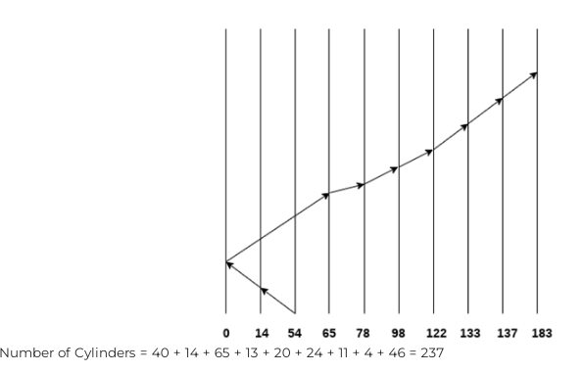
Scan Algorithm
98, 137, 122, 183, 14, 133, 65, 78. Head pointer starting at 54 and moving in left direction.
199

Slide 38
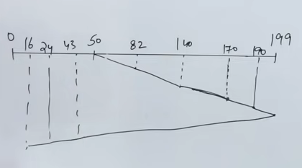
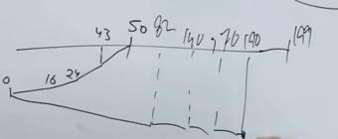
Scan Algorithm Example 2
. 200 Tracks. Request: 82,170,43,140,24,16,190.
Head pointer starting at 50 and moving in right direction
Answer: 332
moving in left direction

Slide 39
C-SCAN (Circular SCAN)
The C-SCAN (Circular SCAN) disk scheduling algorithm is an enhancement of the SCAN algorithm.
Instead of reversing direction after reaching the end of the disk, the C-SCAN algorithm moves the disk arm to the beginning of the disk and continues servicing requests in one direction.
This method provides a more uniform wait time for requests as it treats all requests equally, regardless of their position.

Slide 40
C-SCAN (Circular SCAN)
How C-SCAN Works
Direction of Movement: The disk arm starts moving in one direction (upward or downward) and services all requests in that direction.
Reaching the End: When the disk arm reaches the end of the disk, instead of reversing, it jumps back to the starting position (the beginning of the disk).
Continuing Service: The disk arm then resumes servicing requests from the start of the disk in the same direction.

Slide 41
C-SCAN (Circular SCAN)
Step-by-Step Execution
Initial State: The head is at 53, and it starts moving upwards.
Servicing Requests:
The head services requests in ascending order: 65, 67, 98, 122, 124, 183.
Reaching End: The head continues to the end of the disk (200).
Jump to Start: The head jumps back to the beginning of the disk (0).
Continue Service: The head services the remaining requests in ascending order: 14, 37.

Slide 42
C-SCAN (Circular SCAN)
Example
Consider the following disk request sequence for a disk with 100 tracks
98, 137, 122, 183, 14, 133, 65, 78
Head pointer starting at 54 and moving in left direction. Find the number of head movements in cylinders using C-SCAN scheduling.

Slide 43
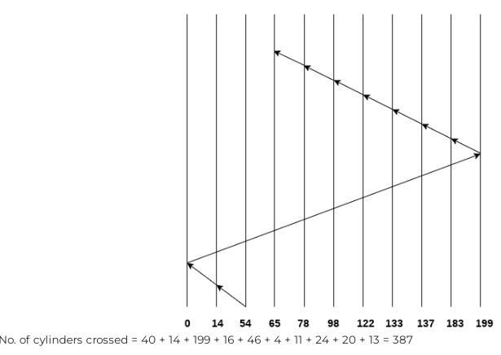
C-SCAN (Circular SCAN)
200 track . 98, 137, 122, 183, 14, 133, 65, 78
Head pointer starting at 54 and moving in left direction.

Slide 44
Look scheduling algo
LOOK scheduling is a variation of the SCAN disk scheduling algorithm,
where the disk head moves in one direction, servicing all requests until it reaches the last request in that direction,
then reverses and moves in the opposite direction to service pending requests.
The key difference between LOOK and SCAN is that the disk head does not move all the way to the end of the disk if there are no requests at the extremes.
Instead, it "looks" ahead for the furthest request and stops there before reversing direction.

Slide 45
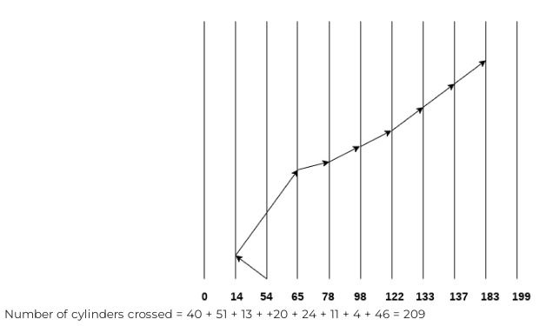
Look scheduling algo
Consider the following disk request sequence for a disk with 100 tracks
98, 137, 122, 183, 14, 133, 65, 78
Head pointer starting at 54 and moving in left direction. Find the number of head movements in cylinders using LOOK scheduling.

Slide 46
C-Look scheduling algo
C-LOOK (Circular LOOK):
Like C-SCAN,
the head only moves in one direction,
and after servicing the furthest request,
it jumps back to the start without servicing requests on the way back.

Slide 47
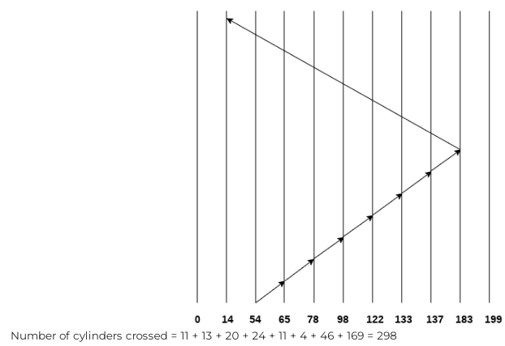
C-Look scheduling algo
Example
Consider the following disk request sequence for a disk with 100 tracks
98, 137, 122, 183, 14, 133, 65, 78
Head pointer starting at 54 and moving in left direction. Find the number of head movements in cylinders using C LOOK scheduling.

Slide 48
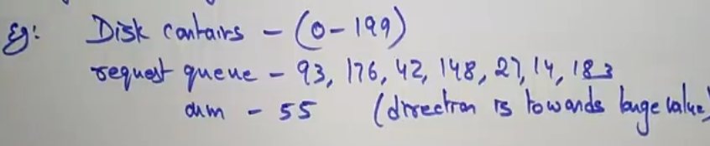
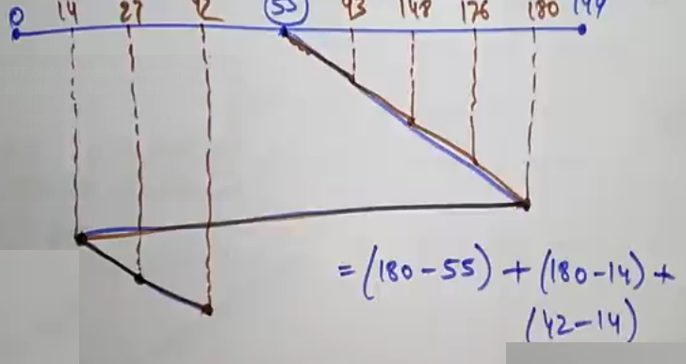
C-Look scheduling algo Example2

